Slide 1
The Aesthetics of Architecture, Interiors & Design 2015 Where Do We Stand Today?

Slide 2
Architecture & Interiors Today: 2015 Deconstructivism
Deconstructivism is a development of postmodern architecture that began in the late 1980s.
Fragmentation, manipulating a structure's surface or skin, non-rectilinear shapes that mix up and confuse traditional elements of architecture, such as structure and envelope.
The visual appearance of deconstructivist buildings is often an overall sense of unpredictability and a controlled chaos.

Slide 3
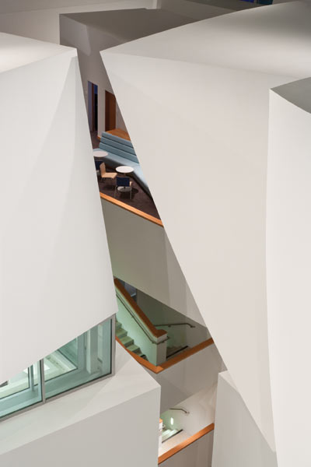
The New World Symphony orchestra academy designed by Frank Gehry, Miami Beach, Florida.

Slide 4
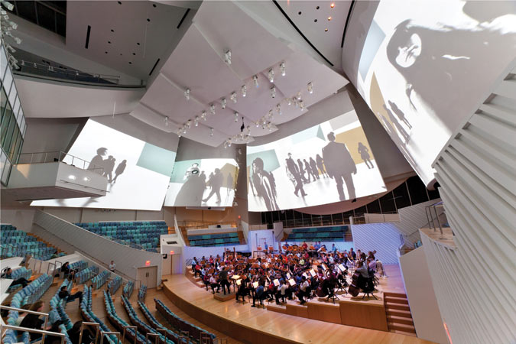

Slide 5
The Lou Ruvo Center for Brain Health, Las Vegas, 2010, designed by Frank Gehry (all photos by Matthew Carbone)

Slide 6
Colliding shapes, unpredictable intersections

Slide 7
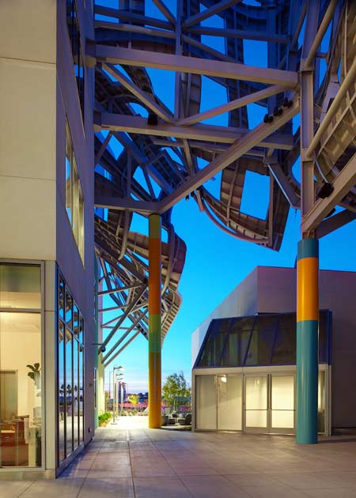

Slide 8
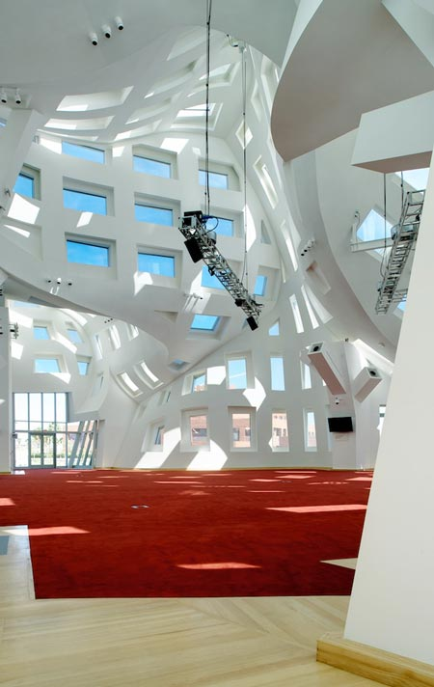

Slide 9
A visual world of disassembled, taken apart, pieces and parts that have been put back together

Slide 10
Architecture Today: 2015 Critical Regionalism:
Critical Regionalism is an approach to architecture that uses the building's cultural and geographical context to create specific and meaningful identity in place of Modernist architecture that is often the same across the globe.
Author and critic Kenneth Frampton proposed that critical regionalism should adopt the ideas of modern architecture, for its admirable progressive qualities but not cookie cutter Modernist forms and surfaces.
Emphasis, Frampton says, should be on topography, climate, light; on tectonic form rather than on mere visual appearance.

Slide 11
Thorncrown Chapel located in Eureka Springs, Arkansas, designed by E. Fay Jones, constructed in 1980.

Slide 12
Constructed mostly of wood and other materials indigenous to northwestern Arkansas, the design minimized material transportation costs.
Though it looks like an open-air structure, the chapel is a glass-enclosed, conditioned space.

Slide 13
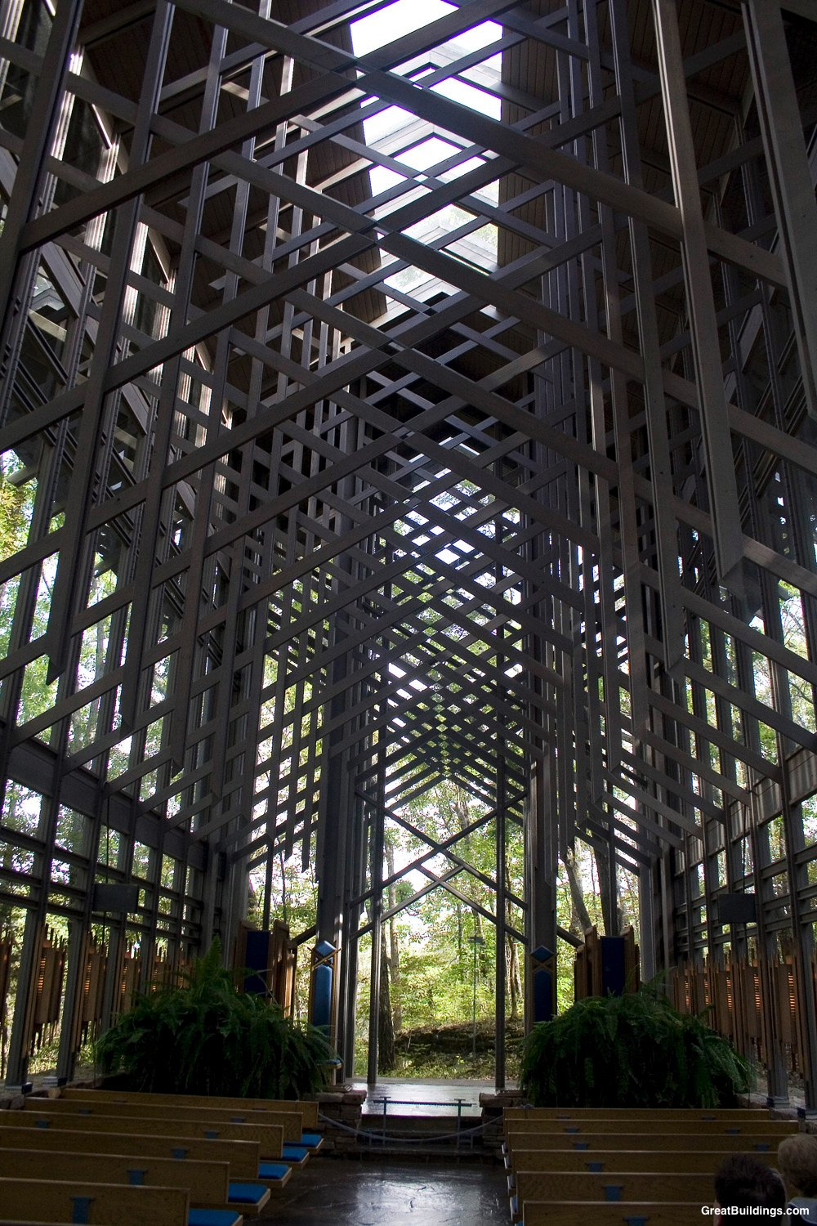
Thorncrown Chapel

Slide 14
Vertical section through Thorncrown Chapel

Slide 16
Architectural responses to local geology and climate. A kind of regionalism without a specific building form or style. M. Gerwing, Architects

Slide 17
Suitcase House 40°20'23 N 116°02'46E Nangou Valley, Badaling, north of Beijing CHINA Gary Chang (EDGE Design)

Slide 18
“Porchdog House” Fayetevill, Arkansas, 2009, designed by Marlon Blackwell.

Slide 19
Critical Regionalism
it favors the small rather than the big plan.
recognizes the importance of the local region in creating its own cultural identity: eg. southeast Ohio.
the actual construction of the building draws on the local methods and history.
it responds to the regional climate and topography.
it emphasizes the ‘tactile’ as well as the visual.

Slide 20
Critical Regionalism
it expresses a sensibility that is off of the ‘mainstream’, global view.

Slide 21
House in Switzerland designed by Peter Zumthor

Slide 22
House in Nova Scotia designed by Brian McKay Lyons

Slide 23
House in Alabama designed by Samuel Mockbee

Slide 24
House in Arizona designed by Antoine Predock

Slide 25
Architecture Today: 2015 “Blob-itecture”
Blobitecture, from blob architecture, is a term for a current movement in architecture for buildings that have an organic, amoeba-shaped, bulging form.
The term 'blob architecture' was popular in the mid-1990s, but the word blobitecture first appeared in print in 2002, in William Safire's "On Language" column in the New York Times Magazine in an article entitled Defenestration.
Intended in the article to have a derogatory meaning, the word stuck and is often used to describe buildings with curved and rounded shapes.

Slide 26
The ‘Kunsthaus Graz’, Austria, 2003, designed Peter Cook and Colin Fournier

Slide 27
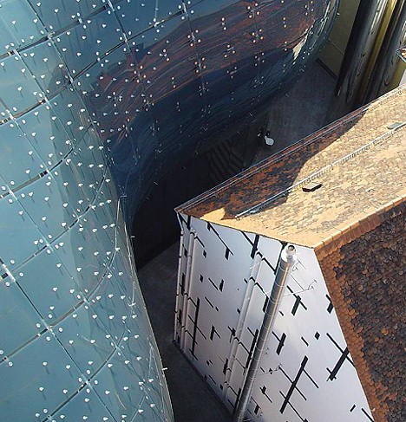

Slide 28
The Sage Gateshead, Newcastle, UK, designed by Foster and Partners, 2004
exterior formed from curved glass and stainless steel

Slide 29
Erick Kristanto, 2011, proposed this project for the international competition to design a Museum of Comic and Cartoon Art

Slide 32
Sustainability as a new measure
Over the past fifteen - twenty years a new concept has taken a major position in the criteria of architecture:
the consideration of sustainability.
To satisfy the requirements of ‘sustainability’ a building must:
be constructed in a way that is environmentally friendly in the production and use of its materials,
in its impact upon the natural and built environment of its surrounding area
in the demands that it makes upon non-sustainable power sources for heating, cooling, water and waste management and lighting

Slide 33
Architecture Today: 2015 Sustainability
Environmental sustainability has become a mainstream popular issue, with major impact on the way architecture is practiced.
Over the past decade, architects have been urged by clients and the general public to take into account the effect buildings have on the environment.
Examples of this include green roof designs, biodegradable materials, and great attention to building energy use. This shift in architecture practice has also changed architecture schools to focus more on the environmental impact of buildings.

Slide 34
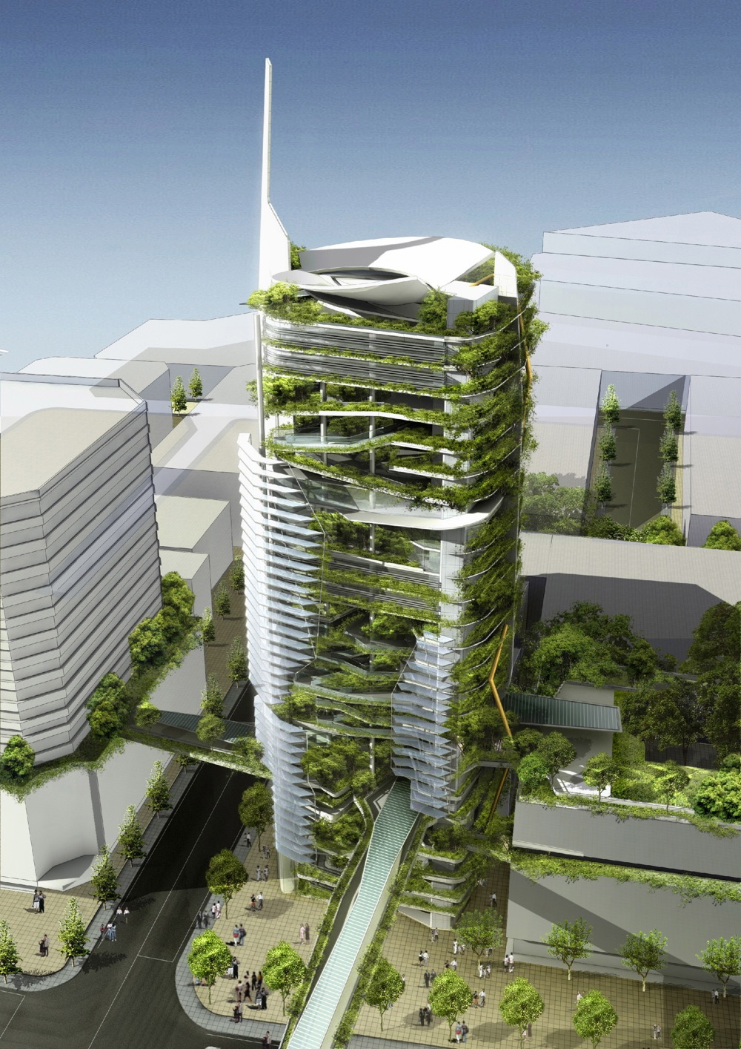
‘living walls’ EDITT TOWER BY KEN YEANG

Slide 35
Growing, literally, the structure of a house

Slide 36
‘living walls’

Slide 38
living roof tops

Slide 39
So, what is ‘aesthetics’ in the realm of architecture, interiors and design?
Standards of beauty vary according to time and culture.
Contemporary culture advocates diversity of styles, even in cases of historic preservation. It also encourages the development of new architectural languages/ways of being expressive.
In 2012 what is considered ‘good architecture’ is complex, multi dimensional, and definitely not singular.
As with most interesting areas of human exploration, the more you study architecture and design, the more you will understand about it.

Slide 40
Tom Wiscombe Design Los Angeles, California

Slide 41
Building on the concept of objects in objects, this project introduces the idea of objectifying the ground, peeling it up from the land.

Slide 42
The structure of the project will be reinforced concrete core and slab construction with concrete perimeter walls and an column grid on the interior of the ground object. Upper levels will be concrete core and slab construction. The skins of the main building will be constructed from lightweight composite materials with honeycomb core, using the natural shell shapes of the project to enable long spans and column-free interiors.

Slide 43
Objects in Objects: The design of the project is based on the formal and organizational model of objects in objects.

Slide 44
Our proposal is to take the idea of ‘boulders’ produced by Walltopia and re-interpret them as architectural objects. These objects are squished and nested into a multi-layered enclosure, creating three-dimensional external and internal climbing surfaces with both hard and soft features.

Slide 45
De Architectura, by the Roman architect Vitruvius in the early 1st century CE is the oldest recorded western writing about architecture.
Vitruvius proposed that a good building should demonstrate three principles:
Firmitas, Utilitas, and Venustas
which translate roughly as –
Durability – it should stand up robustly and remain in good condition.
Utility – it should be useful and function well for the people using it
Beauty – it should delight people and raise their spirits.
These have been used by many architects and designers as guides in creating architecture for centuries.

Slide 46
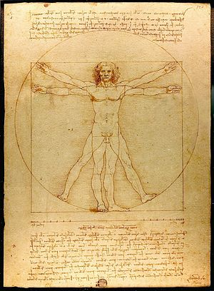
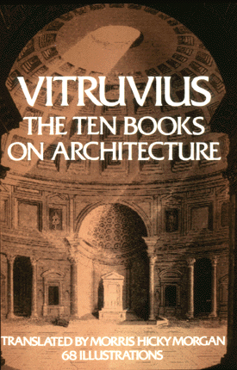
The ‘Vitruvian Man’, 1490, by Leonardo da Vinci & Vitrivius’ famous book on architecture.

Slide 47
Da Vinci’s “Vitruvian Man” is based on the ideas of Vitruvius that ideal human proportions related to geometry.
Leonardo’s drawing of the Vitruvian Man showing the proportions of a man’s body is an example of how Leonardo merged his artistic and scientific studies.

Slide 48
John Ruskin, England, 1819-1900
Ruskin was the leading English art critic of the Victorian era, an art patron, draughtsman, watercolorist, prominent social thinker and critic, and philanthropist.
For Ruskin, the aesthetic, visual, character of a building was the most important element of its meaning.
He stated that a building is not a legitimate work of architecture unless it is somehow "adorned".
For Ruskin, a well-constructed, well-proportioned, functional building needed visual ornament.

Slide 49
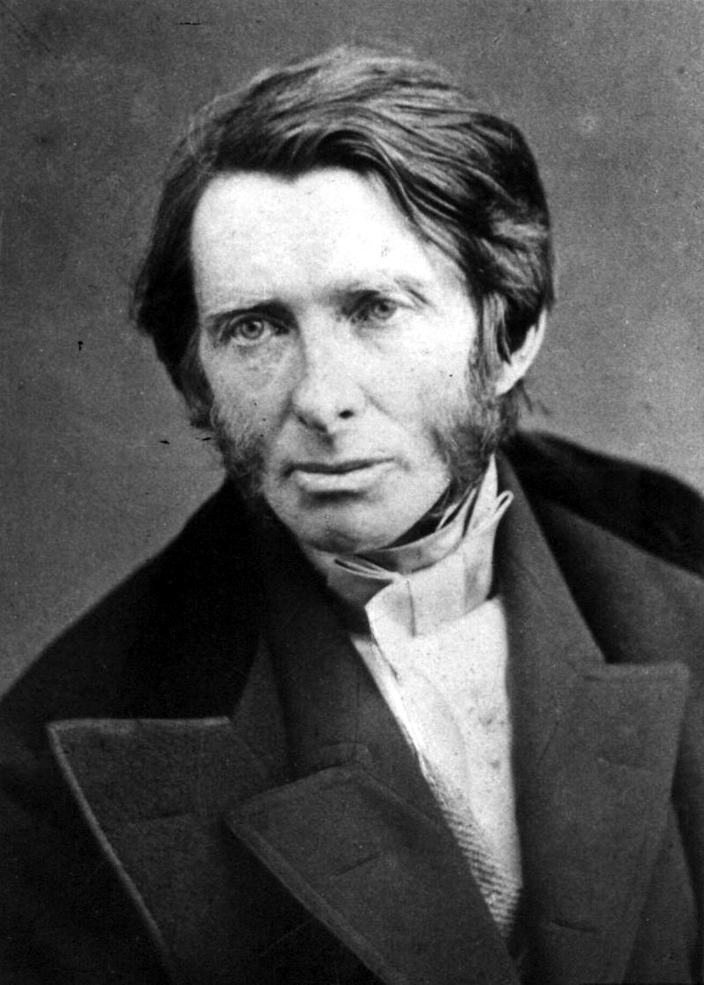
John Ruskin

Slide 50
John Ruskin, in his book “Seven Lamps of Architecture”, published 1849, was much narrower in his view of what constituted architecture.
For Ruskin architecture was the:
"art which so disposes and adorns the edifices raised by men ... that the sight of them" contributes "to his mental health, power, and pleasure.”

Slide 51
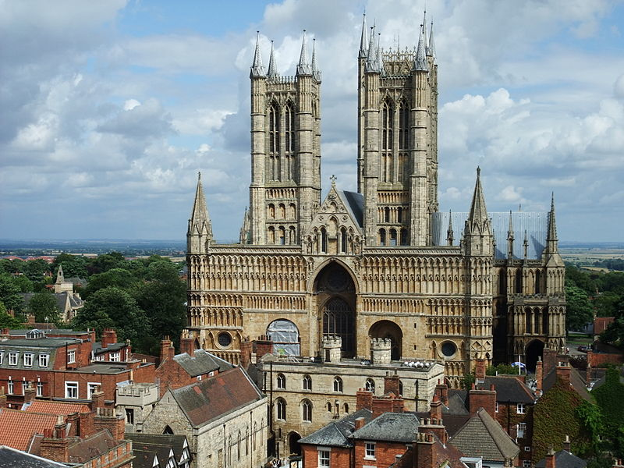
Lincoln Cathedral, England, 1072-1280 A major work of architecture

Slide 52
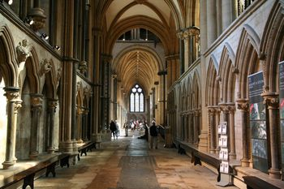
It is highly regarded by architectural scholars; the eminent Victorian writer John Ruskin declared: "I have always held... that the cathedral of Lincoln is out and out the most precious piece of architecture in the British Isles and roughly speaking worth any two other cathedrals we have."

Slide 53
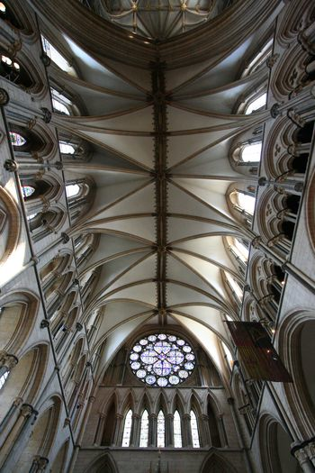
The vaulted ceiling of LIncoln cathedral

Slide 54
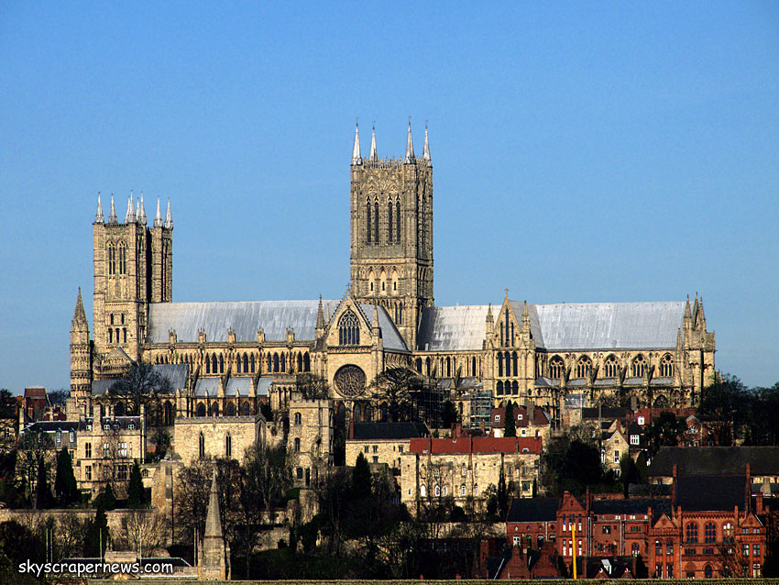
Lincoln cathedral from the south

Slide 55
The European Renaissance and the architect
In Renaissance Europe, from about 1400 onwards, there was a revival of Classical learning, from ancient Rome and Greece.
This revival influenced the development of Renaissance Humanism in which emphasis on the role of the individual in society was far more important than had been during the Medieval period.

Slide 56
The European Renaissance and the architect
Buildings were now seen as being designed by specific architects such as Brunelleschi, Alberti, Michelangelo, Palladio.
With this change the cult of the individual had begun.
There was still no dividing line between artist, architect and engineer, or any of the related vocations, and the appellation was often one of regional preference.

Slide 57
Brunelleschi, 1377-1446 he engineered the dome of the Florence cathedral, 1418

Slide 58
The European Renaissance and the architect
This revival of the Classical learning brought with it a revival of classical style in architecture.
Also at this time there was an intense interest in science and engineering which affected the proportions and structure of buildings.
During this time it was still possible for an artist to design a bridge as the level of structural calculations involved was within the scope of the generalist.

Slide 59
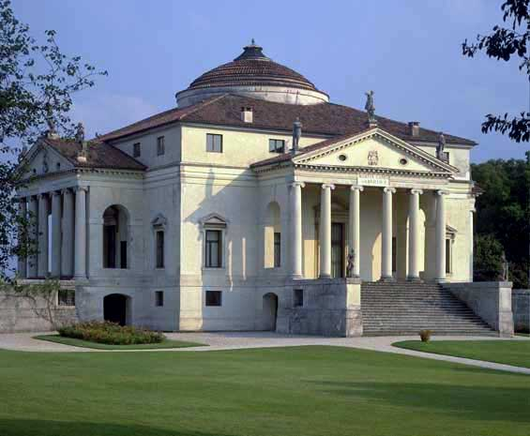
The Villa Capra “La Rotonda”, Vicenza, Italy,1567, by Andrea Palladio An intensely intellectual, formal, and rational work of design. Nothing in this building is the result of ‘chance.’
This kind of approach was considered a
virtue, a good way to design, at this time.

Slide 60
Early modern and the industrial age late 1700’s - early 1800’s
With dramatic developments in science and the discovery and creation of new materials and technology, architecture and engineering began to separate as disciplines.
Architects now began to concentrate on aesthetics and the human experiential aspects of buildings, often at the expense of technical building design issues.

Slide 61
The Crystal Palace, 1851, by Joseph Paxton

Slide 62
Early modern and the industrial age late 1700’s - early 1800’s
During this time the "gentleman architect” became the typical way architecture was practiced.
This was an architect who usually dealt with wealthy clients, primarily on visual qualities usually created by borrowing from historical examples.

Slide 63
Early modern and the industrial age late 1700’s - early 1800’s
At roughly the same time, the Industrial Revolution made it possible for mass production and mass consumption.
‘Aesthetics’ in products and buildings became something the middle class could now think about in their own home environments as ornamented products, formerly expensive, became cheaper because of machine production.

Slide 64
The Industrial Revolution created a new kind of work place; the factory.

Slide 66
‘Function’ and Louis Sullivan
Louis Sullivan, the American architect who designed the first sky scrapers, in the late 1800’s, stated:
"Form follows function".
This way of looking at architecture put "function" in place of Vitruvius' "utility".
"Function” became a widely accepted, all encompassing characteristic of architecture, in which the use, perception and enjoyment of a building, both practical and aesthetic, psychological and cultural depended upon meeting ‘function.’

Slide 67
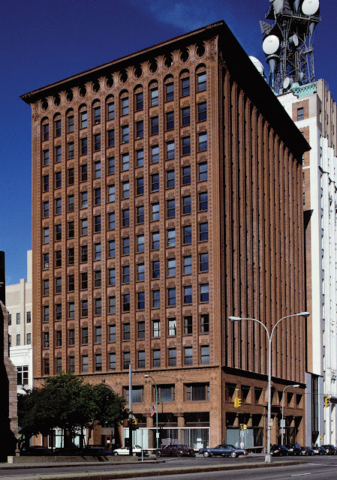
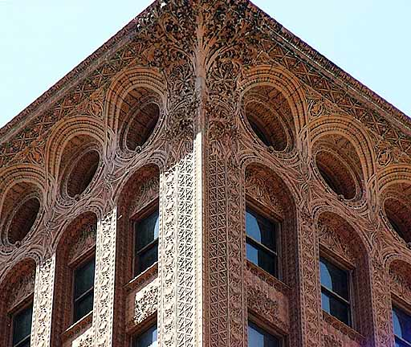
Louis Sullivan, the Guaranty building, 1896, Buffalo, NY,

Slide 68
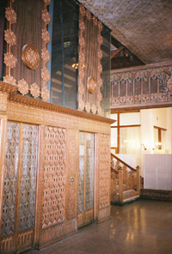
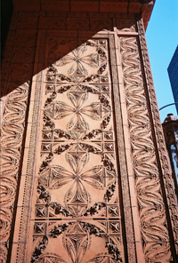
Lobby of the Guaranty building, and terra cotta detail panels.

Slide 69
Description of terra cotta used on the Guaranty building
Terra cotta (Italian for “baked earth”) is a building material that uses clay to form durable fireproof tiles.
It can be formed into very intricate designs.
Once fired at high temperatures, like a clay flowerpot or ceramic dinner plate, terra cotta gives the look and feel of stone, but is comparatively lightweight and inexpensive.
Terra cotta was a favorite material of Louis Sullivan and other late 19th-century architects, both for ornament and as a fire retardant.

Slide 70
Louis H. Sullivan was probably the most important American architect of the 19th century and is still considered the “Father of the Skyscraper.”
Sullivan wanted a bold architectural style for the new building type, the skyscraper.
He wanted this building to express the confidence and prosperity of the United States at the end of the 19th century.
He rejected traditional designs and celebrated the skyscraper’s verticality.
The Guaranty building incorporates a steel structure beneath the masonry exterior.

Slide 71
Early 20th century
What is the difference between "architecture" and mere "construction”?
The architect Le Corbusier wrote:
"You employ stone, wood, and concrete, and with these materials you build houses and palaces: that is construction. Ingenuity is at work.
But suddenly you touch my heart, you do me good. I am happy and I say: This is beautiful.
That is Architecture”.

Slide 72
Early 20th century
On the other hand Ludwig Mies van der Rohe said that architecture begins
"when 2 bricks are put together."

Slide 73
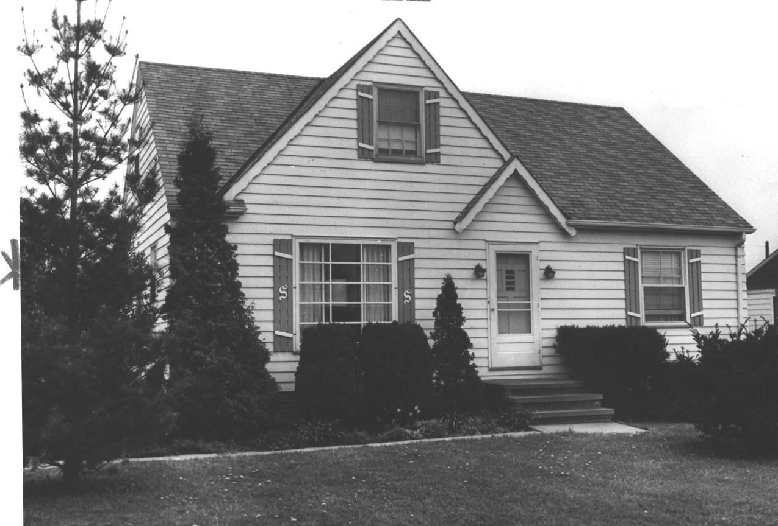
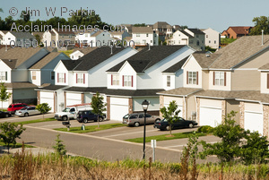
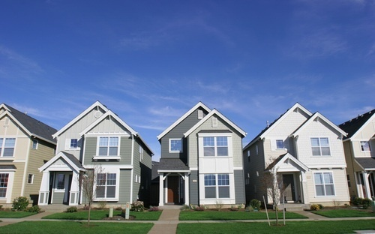
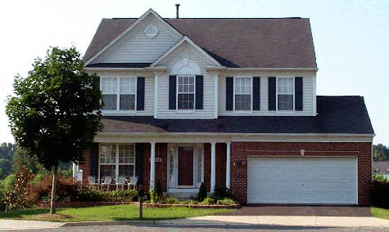
Mere construction is not sufficient to make ‘architecture’, or perhaps we should say ‘good architecture.’

Slide 74
Mere construction is not sufficient to make ‘architecture’, and certainly not ‘good architecture.’
These buildings are houses: they are not architecture and are not ‘designed’ in any meaningful sense.
Built to shelter, and provide a home.
These are not based upon ideas, and are not intended to communicate ideas, or expressions of architectural exploration.
They are not expressions of any particular architect/designer, or office and they are not designed for any particular person.

Slide 75
These houses are, on the other hand, useful, sheltering, and can certainly become sites for the creation of good and interesting lives.
Architecture requires a synthesis of form, material, functionality, and technology.
Inherent in these is the need for ‘idea’ content, for a ‘creative’ interpretation of the setting, and the use of the building.

Slide 76
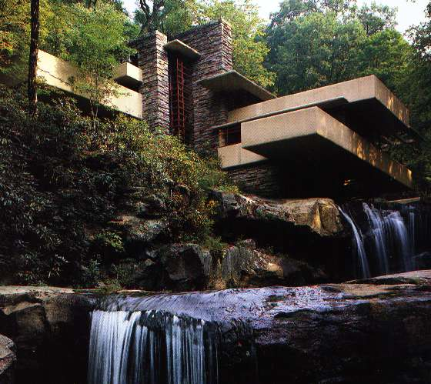
Architecture is not necessarily well constructed (leaking roofs and sagging cantilevers do happen)

Slide 77
Early 20th Century
Around the turn of the 20th century, there was a growing rejection of revivalist architecture and elaborate decoration.
This rejection influenced new ideas that served as early expressions that would in a short time become Modern Architecture.
For example, the Deutscher Werkbund, formed in 1907 to produce better quality machine made objects. This is often noted as the beginning of the profession of industrial design.

Slide 78
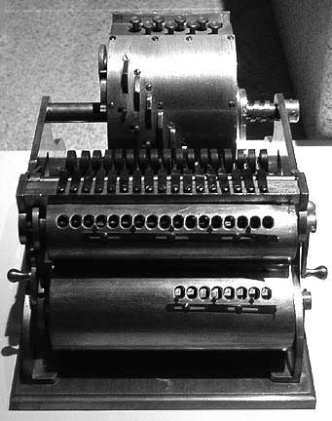
Early 20th Century
At roughly the same time, the Bauhaus school, founded by Walter Gropius, in Weimar, Germany in 1919, redefined architecture as a synthesis of art, craft, and technology.

Slide 79
Bauhaus, famous German school of design that had an enormous influence on modern architecture, industrial design and graphic arts. It was founded in 1919 by the architect Walter Gropius in Weimar, Germany.

Slide 80
Early 20th Century
Modern architecture, of the 1910 – 1915, was an avant-garde movement with moral, philosophical, and aesthetic underpinnings. It had a ‘radical’ character.
Immediately after World War I, 1918 – 1920, modernist architects saw a need to develop a new architecture for the post-war social and economic order, focused on meeting the needs of the growing middle and working classes.

Slide 81
Bauhaus: created an ‘aesthetic’ that has been the standard of ‘high design’ for the past 90 years.
The Bauhaus was based on the principles of the 19th-century English designer William Morris and the Arts and Crafts movement.
Fundamental idea that art should meet the needs of society and that no distinction should be made between fine arts and practical crafts.
Proposed that modern art and architecture must be responsive to the needs and influences of the modern industrial world and that good design must meet both aesthetic standards and sound engineering.

Slide 82
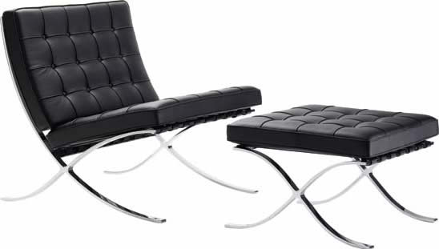
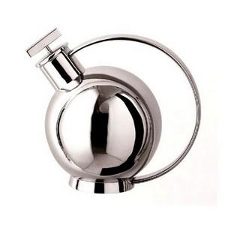
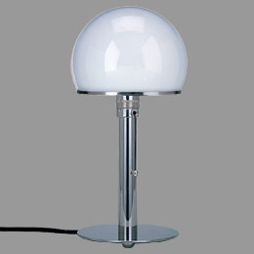
Furniture by Designers at the Bauhaus This table lamp, designed by Wilhelm Wagenfeld in 1924, is often named the Bauhaus lamp. The “Wassily” chair by Marcel Breuer, the “Barcelona” chair and ottoman by Mies van der Rohe.

Slide 83
Early 20th Century
The approach of the Modernist architects was to create buildings as pure forms, without any historical references or ornament.
In place of ornament they offered details that expressed the construction of the building through exposed joints, and material connections .
Buildings now displayed their functional and structural elements, exposing steel beams and concrete surfaces instead of hiding them behind decorative forms.

Slide 84
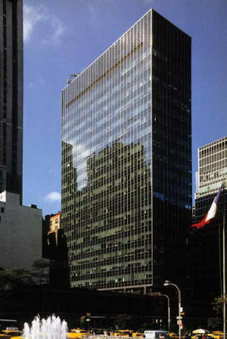
Seagram Building, NY city, Mies van der Rohe, 1958 Lever House, NY city, Skidmore, Owings & Merrill, 1948-52

Slide 85
Frank Lloyd Wright developed what he called ‘Organic’ architecture.
In his ‘Organic’ architecture the form, shape, of the building was strongly influenced by its environment and purpose, function.
Organic architecture was Wright’s attempt to create a coherent responsive relationship, a ‘symbiosis’ between the human built environment and the natural world.
The Robie House and Falling Water are good examples of this idea.

Slide 86
Living room at Taliesin West, Scottsdale, Arizona, 1937, by Frank Lloyd Wright This was his winter home and studio

Slide 87
Taliesin West, 1937 Frank Lloyd Wright’s winter home and studio

Slide 88
Mid-20th century
Architects such as Mies van der Rohe, Philip Johnson and Marcel Breuer, and others, saw beauty in the inherent physical and visual qualities of building materials and modern construction techniques.
These architects did not need historical references or historical ornament in their buildings. They saw those things as being completely irrelevant to contemporary life.
In place of historical reference, these architects celebrated the new materials, and methods of building.

Slide 89
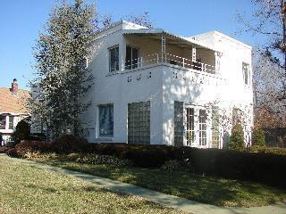
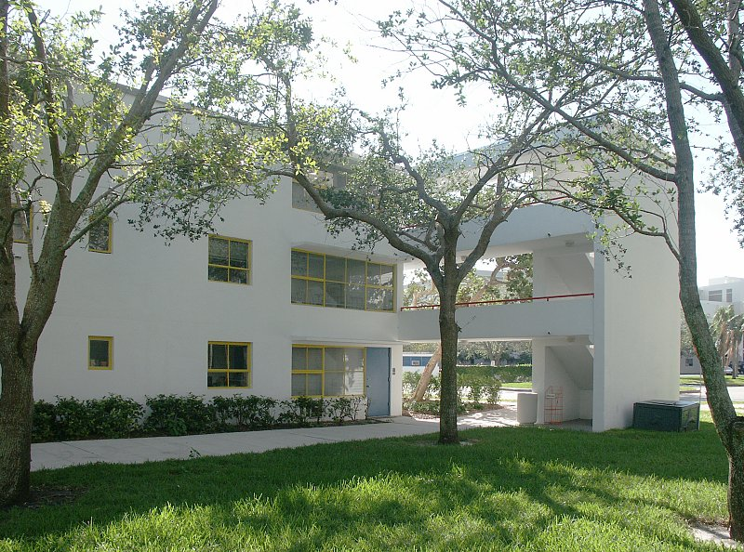
Mid-20th century
By mid-century, Modernism was primarily expressed as the International Style, or the International Style was the predominant expression of Modernism in architecture and product design. Typical forms and surfaces of International Style.

Slide 90
Postmodernism: 1970’s
Many architects found Modernism to be bare, stark, and lacking an overall richness that had been an element of the historical ornamented styles.
As the founders of Modernism and the International Style lost influence in the late 1970s, Postmodernism developed as a reaction against Modernism.
Postmodernism viewed Modernism as being too singular, too austere, too boring, and too dogmatic. Postmodernists wanted to open up the world of design to the possibilities of variety, personality, and humor.

Slide 91
AT&T Building, NY city, Phillip Johnson, 1979 An example of Post Modern expressiveness, including a sense of humor. The top of the building is a classical pediment used in an oversized way.

Slide 92
The remaining slides in this lecture set are a more detailed look at some issues in aesthetics.
I am providing this for your information and interest only.
This content will NOT be addressed on the Final Exam, Exam 7.

Slide 93
Aesthetics in Architecture
Aesthetics has, at some points in time, been primarily about beauty, but the 20th century emphasis on rationality and function pushed beauty aside as a serious intellectual issue.
Aesthetics is about understanding a work of art or architecture "in regard to form and sensory qualities, its processes of production," and its reception, and proposes a theory of taste with standards for judgment, which means providing reasons for saying something is ‘good’ or not.

Slide 94
Aesthetics in Architecture
One classical ‘aesthetic’ view of architecture would not consider its function as an aesthetic component of the architecture. All that mattered was its visual ‘beauty.’
Another view of ‘aesthetic’ aspects of architecture does consider function as an aesthetic component. What the building does, is supposed to do, does matter in how we consider it to be ‘beautiful.’

Slide 95
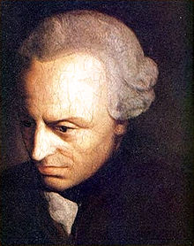
According to the very influential German philosopher Immanuel Kant,1724-1804, the nature of aesthetic response is a disinterested appreciation: a direct, active, and unmediated experience.

Slide 96
Recent aesthetics, in the 20th century, have neglected defining beauty, artistic value, and normative concepts, in favor of a "descriptive, factual approach to the phenomena of art and aesthetic experience.”
Meaning that we do not state what ‘beauty’ is, but rather we describe what we are seeing/experiencing, and what we actually do when we are involved in ‘appreciating’ art, or architecture.

Slide 97
The modern aesthetic question is not "What is beautiful?" but "What can be said to be art?”.
These statements indicate that the question of beauty is somehow outmoded.
Modern artists were forced into reflecting on their discipline by the challenge of photography and the perfection of its beauty.
If the camera could master all the pictorial rules, then painters would subvert them.

Slide 98
Aesthetics and Architecture (which is different from ‘art’ in that it is used, not just viewed)
One position, going back to Roger Scruton’s “Aesthetics of
Architecture”, 1979, and recently updated by Edward Winters, accepts
the necessity of function in general but denies the aesthetic relevance
of particular functions, a position that would justify those who give
priority to formal audacity in art museum architecture.
At the opposite pole, Glenn Parsons and Allen Carlson’s “functional
beauty” proposal would make aesthetic appreciation directly depend
on a building satisfying its “proper” function, a position that would
support those who champion the priority of a museum’s
exhibition functions

Slide 99
‘Free beauty’ vs ‘Dependent beauty’
A judgment of ‘free beauty’ for Kant is a spontaneous
attending to the form of the object as entertained in a
harmonious free play of the imagination and understanding.
Meaning that one way of thinking about beauty is the pure,
unfettered, experience of it, without needing to have any
knowledge of what is being viewed.

Slide 100
A judgment of ‘dependent beauty’ presupposes a concept
of the purpose that determines what the thing is to be.
Meaning that it is important, it is in fact necessary, to know about what you are looking at, experiencing, to be able to ‘appreciate’ it, to have a full aesthetic experience.
Mark Twain (Samuel Clemmons)

Slide 101
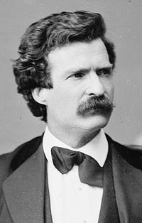
“Two Ways of Seeing a River” by Mark Twain (1883) (An essay on Knowledge vs. No Knowledge)
“Now when I had mastered the language of this water and had come to know every trifling feature that bordered the great river as familiarly as I knew the letters of the alphabet, I had made a valuable acquisition.
But I had lost something, too.
I had lost something which could never be restored to me while I lived.
Mark Twain (Samuel Clemmons)

Slide 102
“Two Ways of Seeing a River” by Mark Twain (1883)
All the grace, the beauty, the poetry had gone out of the majestic river!
I still keep in mind a certain wonderful sunset which I witnessed when steam boating was new to me.”

Slide 103
“Two Ways of Seeing a River” by Mark Twain (1883)
“A broad expanse of the river was turned to blood; in the middle distance the red hue brightened into gold, through which a solitary log came floating, black and conspicuous; in one place a long, slanting mark lay sparkling upon the water;

Slide 104
“Two Ways of Seeing a River” by Mark Twain (1883)
“in another the surface was broken by boiling, tumbling rings, that were as many-tinted as an opal;
where the ruddy flush was faintest, was a smooth spot that was covered with graceful circles and radiating lines, ever so delicately traced;”

Slide 105
“Two Ways of Seeing a River” by Mark Twain (1883)
“the shore on our left was densely wooded, and the sombre shadow that fell from this forest was broken in one place by a long, ruffled trail that shone like silver; and high above the forest wall a clean-stemmed dead tree waved a single leafy bough that glowed like a flame in the unobstructed splendor that was flowing from the sun.
There were graceful curves, reflected images, woody heights, soft distances; and over the whole scene, far and near, the dissolving lights drifted steadily, enriching it, every passing moment, with new marvels of coloring.”

Slide 106
“Two Ways of Seeing a River” by Mark Twain (1883)
“I stood like one bewitched.
I drank it in, in a speechless rapture.
The world was new to me, and I had never seen anything like this at home.
But as I have said, a day came when I began to cease from noting the glories and the charms which the moon and the sun and the twilight wrought upon the river's face; another day came when I ceased altogether to note them.

Slide 107
“Two Ways of Seeing a River” by Mark Twain (1883)
“Then, if that sunset scene had been repeated, I should have looked upon it without rapture, and should have commented upon it, inwardly, in this fashion:”

Slide 108
“Two Ways of Seeing a River” by Mark Twain (1883)
"This sun means that we are going to have wind to-morrow; that floating log means that the river is rising, small thanks to it; that slanting mark on the water refers to a bluff reef which is going to kill somebody's steamboat one of these nights, if it keeps on stretching out like that;

Slide 109
“Two Ways of Seeing a River” by Mark Twain (1883)
“those tumbling 'boils' show a dissolving bar and a changing channel there;
the lines and circles in the slick water over yonder are a warning that that troublesome place is shoaling up dangerously;
that silver streak in the shadow of the forest is the 'break' from a new snag, and he has located himself in the very best place he could have found to fish for steamboats;”

Slide 110
“Two Ways of Seeing a River” by Mark Twain (1883)
“that tall dead tree, with a single living branch, is not going to last long, and then how is a body ever going to get through this blind place at night without the friendly old landmark?"
No, the romance and the beauty were all gone from the river.”

